Slide 1

#RahoAmbitious
TechM Full Stack Software Development

Slide 2




Course: Software Testing
Lecture On: Back-End Automation
Instructor: Bibek Prasad

Slide 3
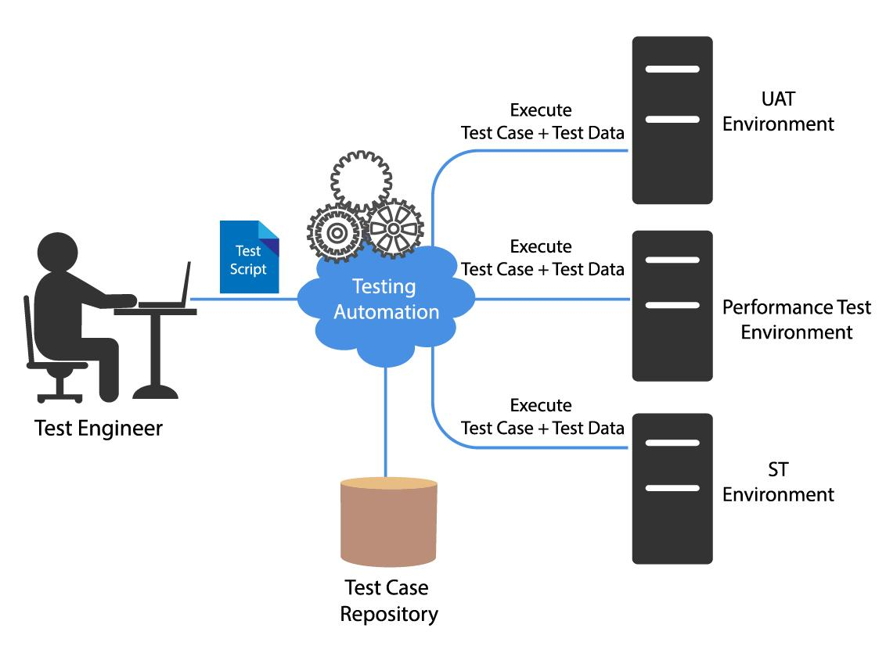
In the last class…
We understood the importance of using test automation frameworks and learnt about the working of a data-driven framework and its implementation in detail.
You learnt about the Page Object Model and its importance in building test scripts.
You then moved to back-end testing and learnt why it is important.
You learnt about different APIs and why API testing is an inevitable part of back-end testing.
You learnt about REST-assured, which enables you to test RESTful APIs in Java.

Slide 4



Poll 1 (15 Sec)
What are the advantages of back-end testing?
(Note: More than one option can be correct.)
It helps us test APIs, servers and databases.
It provides a more comprehensive system with bugs being fixed at an initial stage.
It provides complete test code coverage.
It enhances the quality of the application.
Practice in teams of 4 students
Industry expert mentoring to learn better
Get personalised feedback for improvements

Slide 5
Poll 1 (Answer)
What are the advantages of backend testing?
(Note: More than one option can be correct.)
It helps us test APIs, servers and databases.
It provides a more comprehensive system with bugs being fixed at an initial stage.
It provides complete test code coverage.
It enhances the quality of the application.
Practice in teams of 4 students
Industry expert mentoring to learn better
Get personalised feedback for improvements

Slide 6
Poll 2 (15 Sec)
Can we use Selenium WebDriver for back-end testing?
Yes
No
Practice in teams of 4 students
Industry expert mentoring to learn better
Get personalised feedback for improvements

Slide 7
Poll 2 (Answer)
Can we use Selenium WebDriver for back-end testing?
Yes
No
Practice in teams of 4 students
Industry expert mentoring to learn better
Get personalised feedback for improvements

Slide 8

Today’s Agenda
1
JSONPath
2
GET vs POST
3
Automate POST APIs using REST-assured
4
Basic API automation using POSTMAN
5
Chrome DevTools for testing
6
Importance of API testing in bug detection

Slide 9
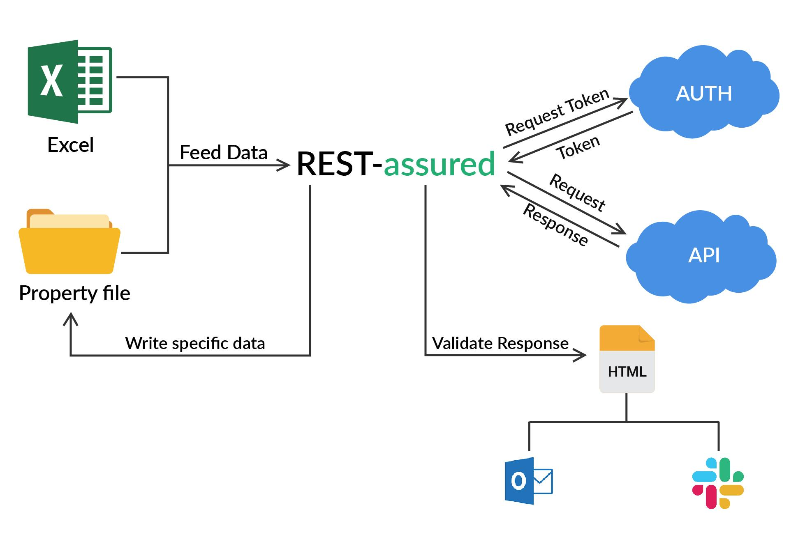
Rest Assured
What is REST-Assured?
REST-assured enables you to test and validate REST services in Java.
It is easy to integrate REST-assured with Maven.
REST-assured is used to test XML- as well as JSON-based web services. It can be integrated with TestNG frameworks for writing test cases for the application under test.
REST-assured supports GET, POST, PUT and DELETE requests, and it can be used to validate and verify the responses received on these requests.

Slide 10
Rest Assured
REST-Assured - Maven Dependency
You need to add the following dependencies to your pom.xml file to include REST-assured in your project.
<dependency>
<groupId>io.rest-assured</groupId>
<artifactId>rest-assured</artifactId>
<version>3.0.2</version>
<scope>test</scope>
</dependency>
You also need to add the standalone JSONPath dependency, which makes parsing of the JSON file easier.
<dependency>
<groupId>com.jayway.jsonpath</groupId>
<artifactId>json-path</artifactId>
<version>2.4.0</version>
</dependency>

Slide 11
Rest Assured
REST-Assured Methods
Method | Description
given() | This method is used to set the background by passing the request header. It is an optional method.
when() | This method is used to initiate a GET/POST/PUT/DELETE request and perform an action when the request is complete.
method() | This method can be substituted with any of the CRUD operations.
then() | This method consists of the conditions that need to be fulfilled when the when() condition gets satisfied.

Slide 12
Rest Assured
REST-Assured Syntax
given().
header().
when().
get()./post()./put().
method().
then().
statusCode(200).
body();

Slide 13
Rest Assured
REST-Assured
Let’s consider a simple JSON file containing the following data.
{
"person":{
"name": Prachi,
"id": 20,
"departments":[
{
"deptID": 1
},
{
"deptID": 2
}
]
}
}
Now, you can easily use REST-assured to validate the response given below.
@Test public void
person_resource_returns_200_with_expected_department() {
when().
get("/person/{id}", 20).
then().
statusCode(200).
body("person.id", equalTo(20),
"person.departments.deptId", hasItems(1, 2));
}

Slide 14
Rest Assured
REST-Assured - GET
@Test
public void TestCase1() throws InterruptedException {
RestAssured.baseURI ="https://developers.zomato.com/api/v2.1";
RequestSpecification request = RestAssured.given();
request.header("user-key","7b8c2002a92c21109f1dfd2808ea50e1");
request.header("Accept","application/json");
Response response = request.get("/categories");
int statusCode = response.getStatusCode();
System.out.println(statusCode);
Assert.assertEquals(statusCode,200);
JsonPath jsonPathEvaluator = response.jsonPath();
String category_1 = jsonPathEvaluator.get("categories[0].categories.name").toString();
Assert.assertEquals(category_1,"Delivery");
}

Slide 15
Poll 3 (15 Sec)
State whether the following statement is true or false.
REST-assured is used to test only JSON-based web services.
True
False
Practice in teams of 4 students
Industry expert mentoring to learn better
Get personalised feedback for improvements

Slide 16
Poll 3 (Answer)
State whether the following statement is true or false.
REST-assured is used to test only JSON-based web services.
True
False
Practice in teams of 4 students
Industry expert mentoring to learn better
Get personalised feedback for improvements

Slide 17
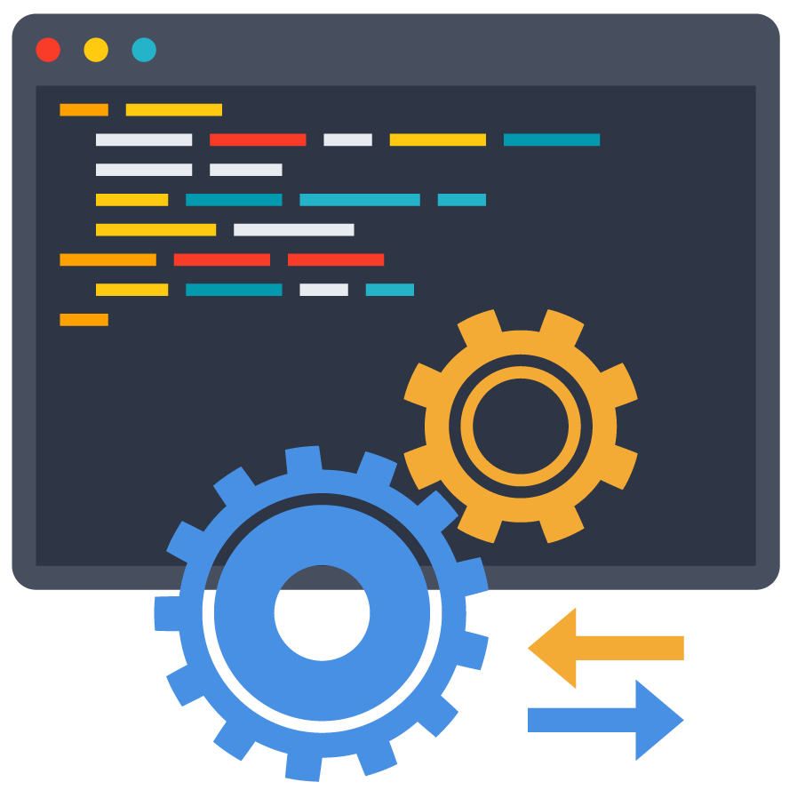
JSONPath

Slide 18
Poll 4 (15 Sec)
JSON stands for:
Java Standard Object Notation
Java Script Object Notation
JavaScript Object Notation
Java Scripting Object Notation
Practice in teams of 4 students
Industry expert mentoring to learn better
Get personalised feedback for improvements

Slide 19
Poll 4 (Answer)
JSON stands for:
Java Standard Object Notation
Java Script Object Notation
JavaScript Object Notation
Java Scripting Object Notation
Practice in teams of 4 students
Industry expert mentoring to learn better
Get personalised feedback for improvements
11

Slide 20
JSONPath
JSON
JSON stands for JavaScript Object Notation.
To be transferred between servers and browsers, the data needs to be in text format only.
JSON is a text format, which can be converted to object notation; hence, it is called JavaScript Object Notation.
Therefore, JSON is used for storing and exchanging data. It can be stored as JavaScript (JS) objects. JSON can be converted to text while being sent across a network, and it can be converted back to objects when they are received.
{ "nationality": "Indian", "Persons": [ { "name": "Prachi Agrawal",, "city": "Mumbai" }, { "name": "Abhinav Chauhan", "city": "Bangalore" } ] }

Slide 21
JSONPath
Introduction to JSONPath
While studying REST-assured, we added a dependency for JSONPath. So, let’s see what JSONPath exactly is and why we need to add a dependency of the same in our project while writing the automation script for the back end.
JSONPath is a query language, which is used to select and extract property values from a JSON document.
<!-- https://mvnrepository.com/artifact/com.jayway.jsonpath/json-path -->
<dependency>
<groupId>com.jayway.jsonpath</groupId>
<artifactId>json-path</artifactId>
<version>2.4.0</version>
</dependency>

Slide 22
JSONPath
JSONPath Syntax
There are a few syntax rules for JSONPath. A few of them are given in the table below:
Syntax | Description
$ | It refers to the root element of a JSON document.
@ | It refers to the current element of a JSON document.
. | It refers to the child element of the current JSON document.
* | It refers to all the elements of a JSON document.
? | It refers to the elements that meet a certain criterion.
, | It refers to the union of the children elements.

Slide 23
JSONPath
How to Parse JSON Using JSONPath?
Suppose you have the following JSON document:
Now, here’s how you can use JSONPath:
{ "movie": { "name": "URI", "cast": [ { "actor": "Vicky Kaushal", "actress": "Yami Gautam", "director": "Aditya Dhar", } ] }
import com.jayway.jsonpath.JsonPath; public class ParseJSON { static String json = "..."; public static void main(String[] args) { String movieName = JsonPath.read(json, "$.movie.name"); System.out.println(movieName); Integer casts = JsonPath.read(json, "$.cast.length()"); } }

Slide 24
JSONPath
Why do We Need JSONPath in Back-End Testing?
JSONPath is used with REST-assured to extract specific elements from the API response before proceeding to verify them.
Remember the example you saw earlier? Now, here, we have tried to parse through the given JSON using JSONPath.
JSON
REST-assured
{
"person":{
"name": Prachi,
"id": 20,
"departments":[
{
"deptID": 1
},
{
"deptID": 2
}
]
}
}
@Test public void
person_resource_returns_200_with_expected_department() {
when().
get("/person/{id}", 20).
then().
statusCode(200).
body("person.id", equalTo(20),
"person.departments.deptId", hasItems(1, 2));
}

Slide 25
Poll 5 (15 Sec)
JSONPath is a query language that can be used to parse XML as well as JSON documents.
True
False
Practice in teams of 4 students
Industry expert mentoring to learn better
Get personalised feedback for improvements

Slide 26
Poll 5 (Answer)
JSONPath is a query language that can be used to parse XML as well as JSON documents.
True
False
Practice in teams of 4 students
Industry expert mentoring to learn better
Get personalised feedback for improvements

Slide 27
GET vs POST

Slide 28
GET vs POST
GET | POST
The GET method is used to fetch data from a specified resource. | The POST method is used to send data to a server such that a resource is created or updated.
The parameters passed along with the GET method stay as part of the URL and, hence, they are stored in the browser history. | The parameters passed along with the POST method are not part of the URL and, hence, they are not stored in the browser history.
The GET method should not be used in case you are looking for security and want to share sensitive data. | The POST method can be used while sharing sensitive data.
GET requests have restriction on length. | POST requests do not have any length restriction.

Slide 29
Poll 6 (15 Sec)
POST method stores data in browser history.
True
False
Practice in teams of 4 students
Industry expert mentoring to learn better
Get personalised feedback for improvements

Slide 30
Poll 6 (Answer)
POST method stores data in browser history.
True
False
Practice in teams of 4 students
Industry expert mentoring to learn better
Get personalised feedback for improvements

Slide 31

Automate POST APIs

Slide 32
Automate POST APIs
Why do We Need to Automate POST APIs?
As you now know, you use POST requests when you want to send some business data to the server.
Hence, in a real-world application, a POST request can have quite a complex body structure and can be quite large in size as well.
Because they are critical to businesses and have a complex structure, we would learn how to automate POST API requests/responses.'

Slide 33
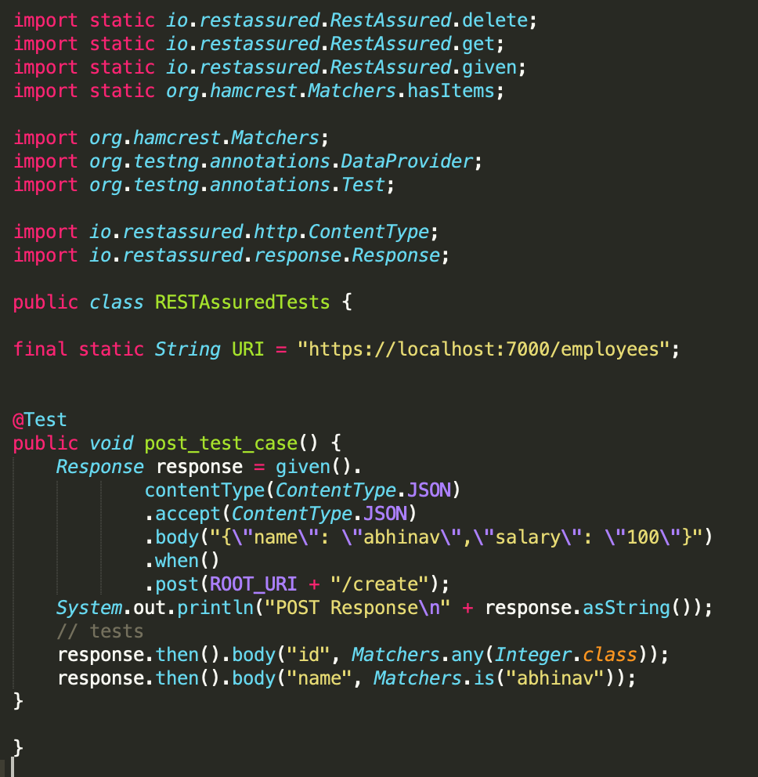
Automate POST APIs
Elements of a POST Request
URL: This is simply the URL of the resource.
POST method: When submitting data using POST, you need to specify the .post() method in REST-assured.
Header: The content type should be set to JSON, if the POST response is of JSON format.
Body: The body part contains the data, which is submitted as a POST request.

Slide 34

Let’s see how we can automate a POST API on zomato.com.

Slide 35
Poll 7 (15 Sec)
Which of the following method/s specifies the content type in REST-assured?
(Note: More than one option can be correct.)
.post()
.when()
.accept()
.then()
Practice in teams of 4 students
Industry expert mentoring to learn better
Get personalised feedback for improvements

Slide 36
Poll 7 (Answer)
Which of the following method/s specifies the content type in REST-assured?
(Note: More than one option can be correct.)
.post()
.when()
.accept()
.then()
Practice in teams of 4 students
Industry expert mentoring to learn better
Get personalised feedback for improvements

Slide 37


Slide 38
POSTMAN
POSTMAN is a tool that allows the user to create and save simple as well as complex HTTP/s requests, and, thereby, offers a feature to automate these requests with ease.
You can download POSTMAN from here.

Slide 39
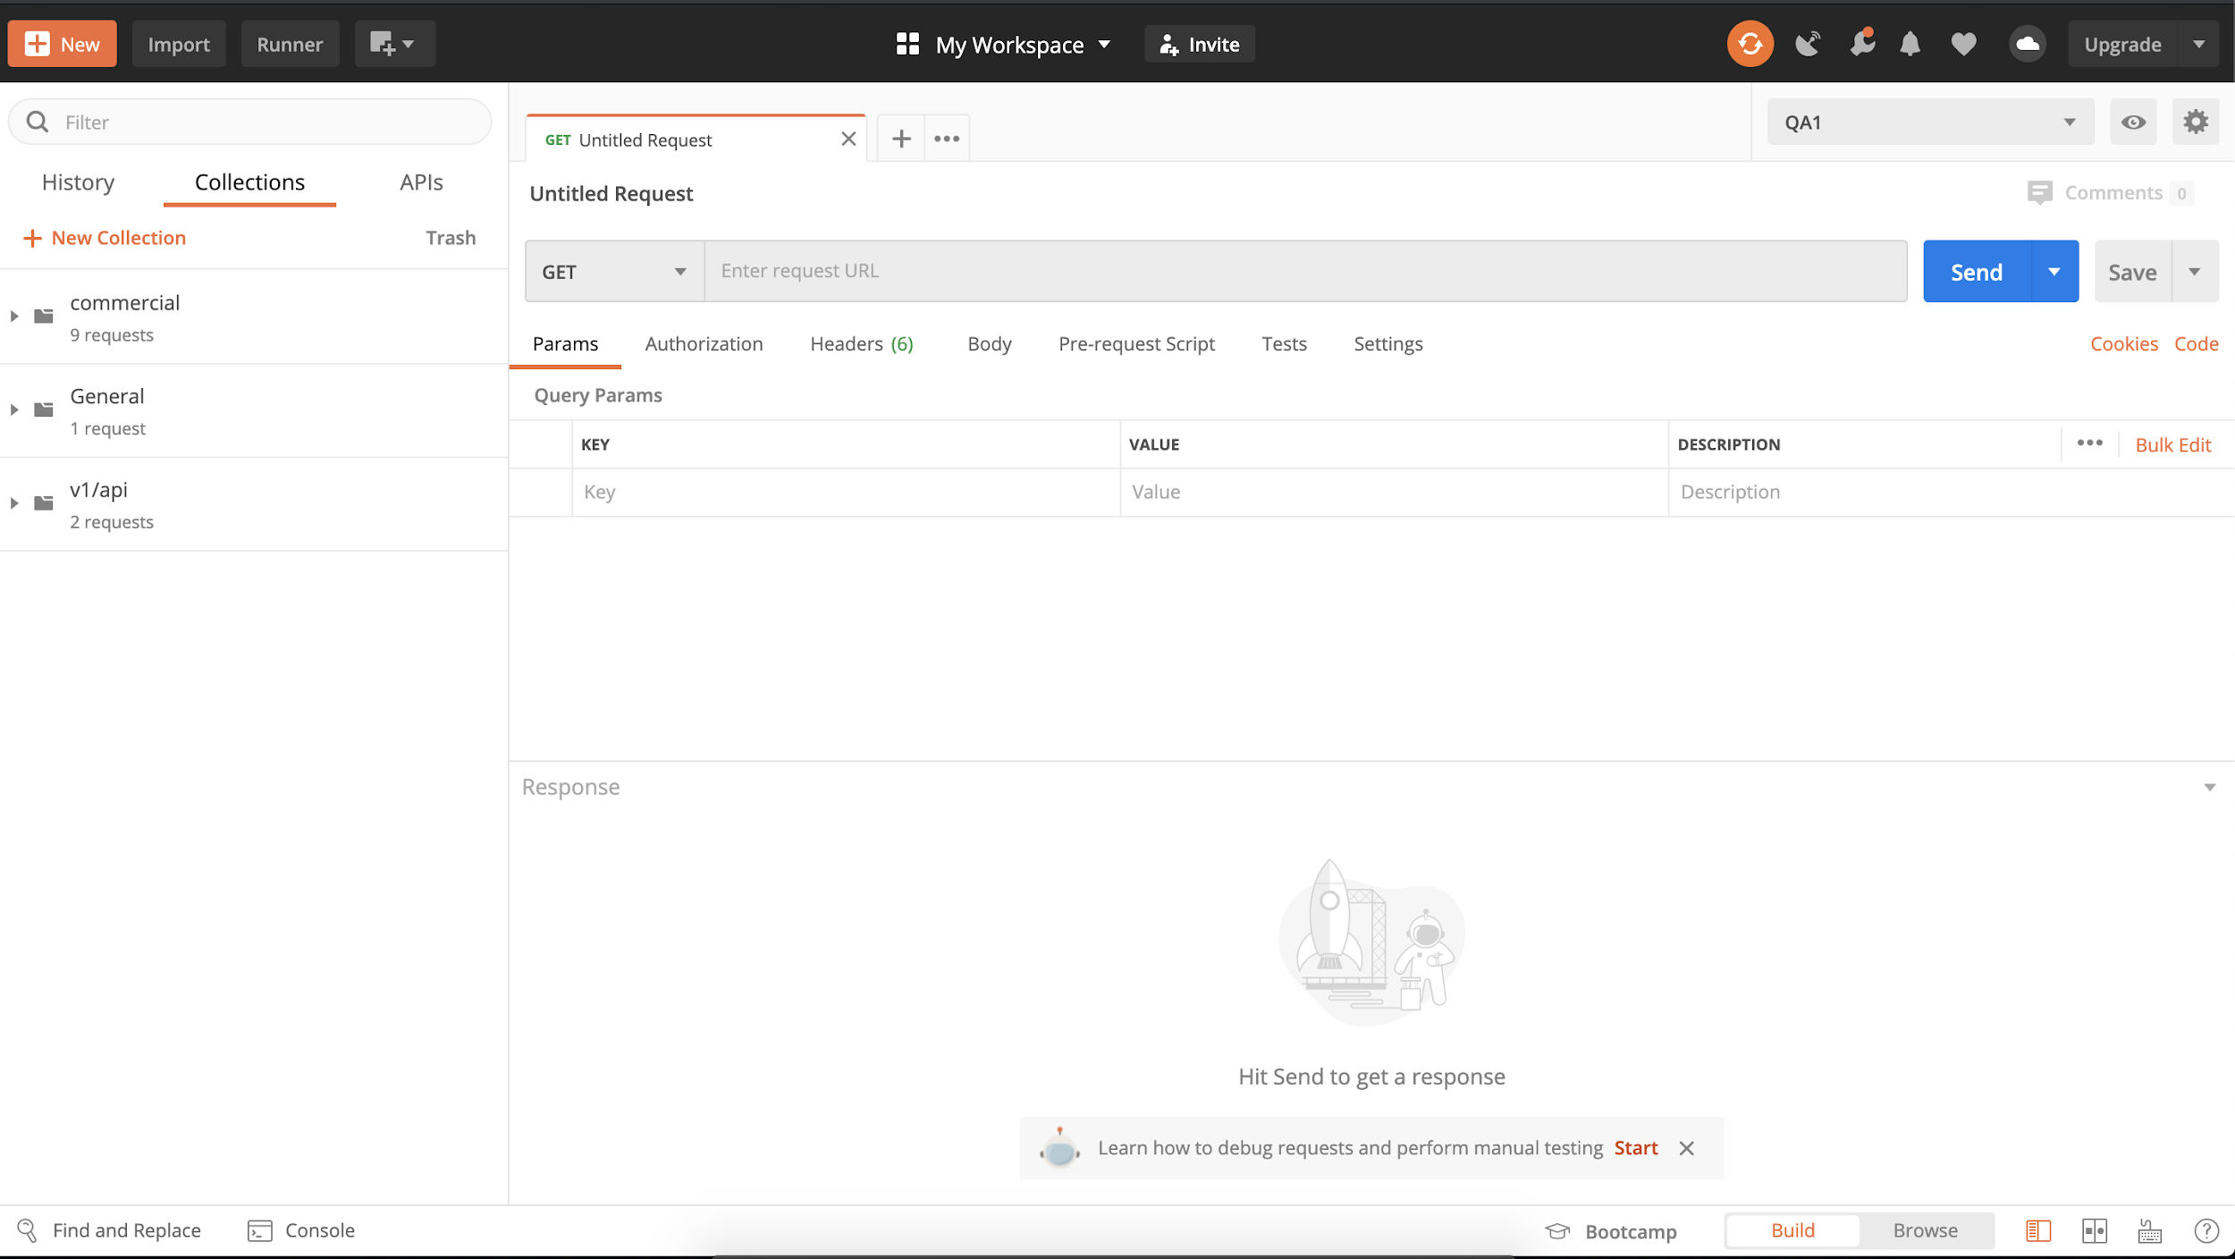
POSTMAN

Slide 40
POSTMAN Terminologies
New: This is where you create a new request, collection or environment.
Import: This is used to import a collection or an environment.
Runner: You can execute automation tests through this Collection Runner.
Request: This displays the title of the request that you are currently working on.
HTTP request: This displays a dropdown list of different requests such as GET, POST, COPY and DELETE.
Request URL: This refers to the endpoint.
Params: This is where you pass the parameters that are needed for a request, such as key–values pairs.
Authorisation: To access APIs, you need proper authorisation. It may be in the form of a username and a password, a bearer token, etc.

Slide 41
POSTMAN Terminologies
Headers: You can set headers such as content type to JSON depending on the contracts of the API.
Body: This is where you pass request details.
Pre-request script: These are scripts that will be executed before a request. Usually, pre-request scripts are used for the setting environment to ensure that the tests run in the correct environment.
Tests: These are scripts that are executed during the firing of a request. It is important to have these tests as it sets up checkpoints to verify whether a response is okay and the expected data is retrieved.

Slide 42
Let’s see how we can perform POSTMAN testing.

Slide 43
Poll 8 (15 Sec)
What is/are the advantages of using POSTMAN for API testing?
It provides us with a user-friendly interface.
It is easy to create a test suite using the POSTMAN testing tool.
It provides a suitable test environment configuration every time we run the test.
All of the above.
Practice in teams of 4 students
Industry expert mentoring to learn better
Get personalised feedback for improvements

Slide 44
Poll 8 (Answer)
What is/are the advantages of using POSTMAN for API testing?
It provides us with a user-friendly interface.
It is easy to create a test suite using the POSTMAN testing tool.
It provides a suitable test environment configuration every time we run the test.
All of the above.
Practice in teams of 4 students
Industry expert mentoring to learn better
Get personalised feedback for improvements

Slide 45

Chrome DevTools

Slide 46
Chrome DevTools
What is Chrome DevTools?
Chrome DevTools is a built-in tool provided in the Google Chrome browser.
Chrome DevTools helps in editing web pages on the fly. It also helps us analyse problems, if any, with a web page.
You can easily access Chrome DevTools by right-clicking on the Chrome browser window and selecting the ‘Inspect' option.
Chrome DevTools can be used on any webpage, and it lets you understand how a particular web page was built.

Slide 47
Chrome DevTools
How Can We Use Chrome DevTools for Testing?
Chrome DevTools plays an important role while performing testing.
The various actions that can be performed using Chrome DevTools include the following:
Inspecting an HTML element
Editing an HTML element
Viewing HTTP requests
Simulating device frames
Simulating performance on slower networks
Investigating page load errors
Generating lighthouse reports
Analysing chromepath

Slide 48
Let’s see how we can use Chrome DevTools for testing purpose.

Slide 49
Project Work (30 mins)
Online Food Ordering Website
Let’s generate a lighthouse report for zomato.com and analyse it.
You can refer to the solution here.

Slide 50

API Testing Helps us Detect Bugs

Slide 51
API Testing Helps us Detect Bugs
API testing helps us detect the following errors/problems/bugs:
Duplicate functionalities
Missing functionalities
Unused flags
Security Issues
API contract deviations
Performance issues and bottlenecks
Connectivity issues with getting a response from an API
Multithreading issues and race conditions
Improper errors/warning
Incorrect handling of valid argument values

Slide 52
Poll 9 (15 Sec)
Which of the following bug/s cannot be detected using API testing?
Missing and duplicate functionalities
Issues with getting a response from an API
Security issues
Missing button on a web page
Practice in teams of 4 students
Industry expert mentoring to learn better
Get personalised feedback for improvements

Slide 53
Poll 9 (15 Sec)
Which of the following bug/s cannot be detected using API testing?
Missing and duplicate functionalities
Issues with getting a response from an API
Security issues
Missing button on a web page
Practice in teams of 4 students
Industry expert mentoring to learn better
Get personalised feedback for improvements

Slide 54
Key Takeaways
You learnt why JSONPath is used to parse JSON documents and how it is important while writing back-end automation scripts using REST-assured
You tried to automate a POST API and learnt how it is done
You learnt about the advantages of POSTMAN in test automation
You also learnt how Chrome DevTools can actually play a vital role in testing

Slide 55
Doubt Clearing (15 min)

Slide 56
Tasks to Complete After Today’s Session
MCQs
Project - Checkpoint 4

Slide 57
#RahoAmbitious
Thank You!

